Slide 1
Object Oriented Programming and Design for Engineering Course No.: 157109
Lab 1: Interfaces

Slide 2
Agenda
Java programming language features
Interfaces
Motivation behind using interfaces
Defining and implementing/extending interfaces in Java
Polymorphism

Slide 3
Java programming language features
Java uses an automatic memory management mechanism (garbage collector) to manage the object lifecycle.
Java is a compiled programming language
The compiler translated the source code to the virtual machine (JVM) language.
A safety mechanism, preventing errors in runtime.
Java is a strongly typed language
Every variable has a type
During compilation, the type is established based on the variable declaration. In runtime, it is possible to assign a variable an instance of a subtype of the declared type.
The types in Java are organized in a single inheritance tree
Every type (except primitives) inherits from the Object class

Slide 4
Java is an (almost) pure Object-Oriented language
Properties of a pure Object-Oriented language:
Encapsulation & Data Hiding
Inheritance
Polymorphism
Abstraction
All pre-defined types should be objects
All user-defined types should be objects
Methods invoked by the objects
Notes:
טיפוסים פרימיטיביים סותרים את התכונה החמישית
פונקציות סטטיות ואופרטורים מובנים כמו "+" סותרים את התכונה השביעית
להסבר נוסף

Slide 5
Java interfaces

Slide 6
Why do we need interfaces?
An interface can be used to define a family of classes
An interface is a contract between the implementing class and the interface clients
A class may implement multiple interfaces, which is a safe alternative to multiple inheritance
Interfaces enables polymorphism

Slide 7
Important comments on interfaces
An interface cannot inherit from a class, but it may extend another interfaces.
It is not possible to instantiate an interface.
Interface-variables are implicitly public static final
Interface-methods are implicitly public abstract
A class implementing an interface must implement all methods defined by the interface.
Exception: an abstract class. Such a class cannot be instantiated.

Slide 8

Why do we need interfaces? (1)
Defining a family of classes

Slide 9
A family of classes
We would like to model a family of fruits. Each fruit can grow and be harvested.
We will initially build two fruit classes:
Orange
Apple
Each class will contain two methods:
grow()
harvest()

Slide 10
Possible implementation
public class Orange {
public void grow() {
System.out.println(
“Orange growing 1 cm”);
}
public void harvest() {
System.out.println(
“harvesting 2 oranges”);
}
}
public class Apple {
public void grow() {
System.out.println(
“Apple growing 5 cm”);
}
public void harvest() {
System.out.println(
“harvesting 3 apples”);
}
}

Slide 11
Instantiation and method invokation
Orange orange = new Orange();
orange.grow();
Apple apple = new Apple();
apple.grow();
Output:
Orange growing 1 cm
Apple growing 5 cm

Slide 12
Defining an interface
We would like to define the fruits as one ‘family’ and allow adding new members into this family. Java interfaces achieves both goals
Defining an interface
An interface is a collection of method signatures (with no implementation) which defines a type of behavior. In addition, an interface can also include a declaration of constants
In our example:
public interface IFruit{
void grow(); //public abstract void grow()
void harvest();
}
By default, each method is defined as public and abstract

Slide 13
Adding a new implementation
public class Cherry implements IFruit {
public void grow() {
// implementation
}
public void harvest() {
// implementation
}
}
Instantiating and invoking a method
Cherry cherry = new Cherry();
cherry.grow();
Alternatively, the field can be declared as an Ifruit:
IFruit cherry= new Cherry();
cherry.grow();

Slide 14
UML notation
<<interface>> IFruit
grow(): void harvest(): void
Implements
Cherry

Slide 15
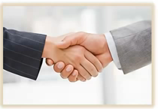
Why do we need interfaces? (2)
An interface is a contract between the implementing class and the interface clients

Slide 16
An example for a contract: Comparable
Java has the following interface for classes that function as comparable objects:
public interface Comparable<T> {
int compareTo(T obj);
}
The compareTo function returns:
A positive number – if the current object (this) is larger than obj
Zero – if the current object is equal to obj
A negative number – if the current object is smaller than obj

Slide 17
A class implementing Comparable
public class Date implements Comparable<Date> { private int day; private int month; private int year; @Override public int compareTo(Date d2) { int yearDiff = this.year - d2.year; if (yearDiff != 0) return yearDiff; int monthDiff = this.month - d2.month; if (monthDiff != 0) return monthDiff; return this.day - d2.day; } }

Slide 18
A second class implementing Comparable
In the following example we define the class Author which is Comparable.
The class has three fields: first name, family name, book name.
Comparison logic: by first name then by family name.

Slide 19
Author implementation
public class Author implements Comparable<Author> {
String firstName;
String lastName;
String bookName;
Author(String firstName, String lastName, String bookName) {
this.firstName = firstName;
this.lastName = lastName;
this.bookName = bookName;
}
public int compareTo(Author au) {
int last = this.lastName.compareTo(au.lastName);
return last == 0 ? this.firstName.compareTo(au.firstName) : last;
}
}

Slide 20

Why do we need interfaces? (3)
A class may implement multiple interfaces, which is a safe alternative to multiple inheritance.

Slide 21
Multiple inheritance
Multiple inheritance is the case when one class inherits from more than one class.
For example, C inherits both from A and from B

Slide 22
Multiple inheritance is problematic
Diamond inheritance
Ambiguous
C c = new C();
c.f(); ???
Notes:
בשפת c++ פותרים את הבעיה באמצעות שימוש בשם מחלקת הבסיס שממנה רוצים לקחת את המימוש. בדוגמה למעלה ניתן לכתוב c.A::f() או c.B::f(). כמובן שיש כאן סרבול.
על מנת לפתור את בעיית ירושת היהלום ב c++, יש בשפה מנגנון של virtual inheritence שמבטיחה שייווצר רק מופע אחד של ה"סבא". גם כאן יש מגבלות וסיבוכים. לפרטים: https://www.makeuseof.com/what-is-diamond-problem-in-cpp/#:~:text=The%20solution%20to%20the%20diamond%20problem%20is%20to%20use%20the,class%20in%20the%20child%20class.

Slide 23
Solving the problems of multiple inheritance
Java does not permit multiple inheritance
A class may inherit only a single class. However, a class may implement multiple interfaces.
public class C extends D implements A, B {
….
}

Slide 24
Implementing multiple interfaces and interface inheritance
A1
methodA1() toString()
C1
methodI1() methodI2()
<<interface>> I1
methodI1()
B1
methodI1() methodI2()
<<interface>> I2
methodI2()
D1
methodI1()
Notes:
We identify four things:
Interface I1 which has the following method signature in it: void methodI1()
Interface I2 which has the following method signature in it: void methodI2()
Class A1 in which 2 methods have been defined: methodA1() and toString()
Class B1 which also inherits class A1 and also implements interface I2 (which in turn, inherits interface I1).
When we say that class B1 inherits class A1, we're saying that the two methods: methodA1() and toString() which belong to class A1 are also in class B1.
Similarly, when we say that class B1 implements interface I2, we're saying two things.
First thing:
Class B1 must implement each of the methods found in interface I2, that is, it must implement the method methodI1() which it inherits from interface I1 and the method methodI2() which is found in interface I2.
We'll summarize a few of the methods found in class B1:
The method methodI1()
The method methodI2()
The method methodA1()
The method toString()

Slide 25
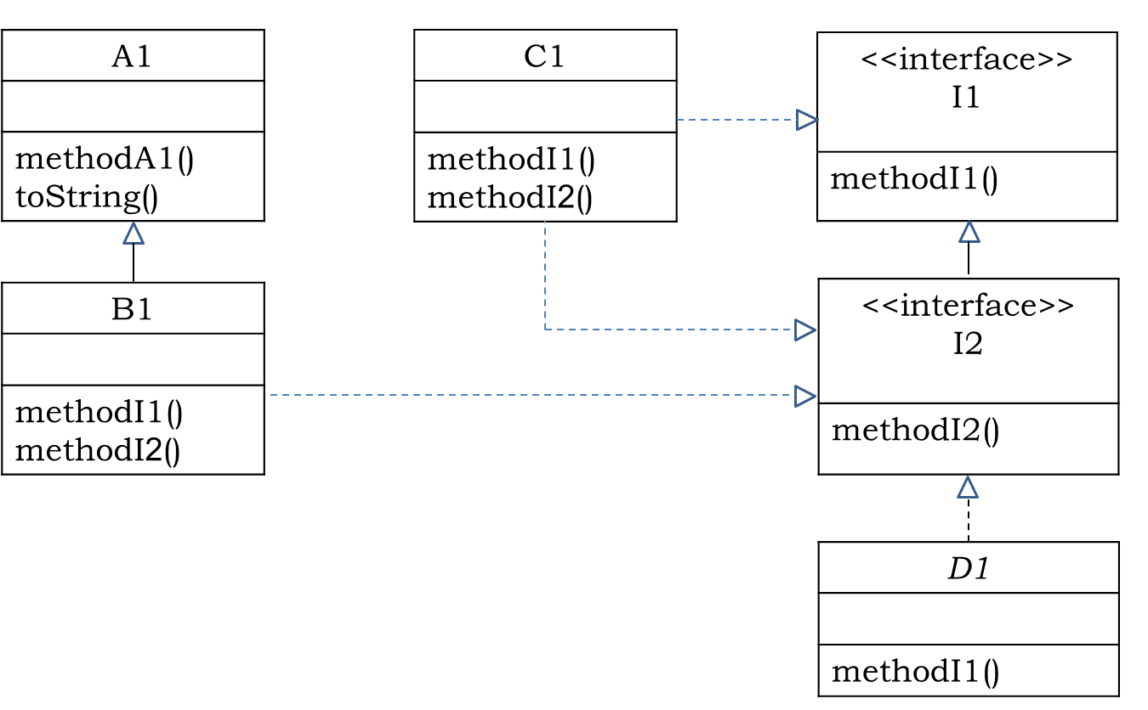
Declaring a variable which implements an interface
Suppose we created an object of the type B1 using:
[Type] b1 = new B1();
What are the possible declared types for the variable b1?
B1 b1 = new B1();
A1 b1 = new B1();
I2 b1 = new B1();
I1 b1 = new B1();
Object b1 = new B1();
Notes:
Answer
There are 4 options since an object of type sub-class is also of type super-class.
First option:
B1 yadit = new B1();
This is the trivial option.
Second option:
A1 yadit = new B1();
The class B1 inherits the class A1 and therefore every object of type sub-class (class B1) is also of type super-class (class A1).
Third option:
I2 yadit = new B1();
The class B1 implements (inherits) the interface I2 and therefore every object of type sub-class (class B1) is also of type super-class (class I2).
Fourth option:
I1 yadit = new B1();
The class B1 implements (inherits) the interface I1 and therefore every object of type sub-class (class B1) is also of type super-class (class I1).

Slide 26
Using a variable which implements an interface
Question
Look at the following code and determine whether it compiles. If so, which code will run?
I1 b1 = new B1();
b1.methodI1();
I1 b1 = new B1();
(I2)b1.methodI2();
I1 b1 = new B1();
b1.methodI2();
Object b1 = new B1();
b1.methodI1();
((I1)b1).methodI1();
((I2)b1).methodI1();
((B1)b1).methodI1();
Notes:
Question
Look at the following code and determine whether command 2 can be compiled? If so, which code will run?
I1 b1 = new B1();
b1.methodI1();
Answer
The compiler checks the command and says to itself: The handle yadit is of type I1, does the method methodI1() appear in interface I1? The answer is yes and therefore the command can be compiled.
Of course, while running, the method methodsI1() which belongs to object of type B1 is the one running.
Question
Look at the following code and determine whether command 2 can be compiled?
I1 yadit = new B1(); (1)
yadit.methodI2(); (2)
Answer
The compiler checks the command and says to itself: The handle yadit is of type I1, does the method methodI2() appear in interface I1? The answer is no and therefore the command cannot be compiled. Therefore we need to perform downcasting in order for the code to compile:
I1 yadit = new B1(); (1)
((I2)yadit).methodI2(); (2)
The compiler checks command 2 and says to itself: The handle yadit is temporarily of type I2, is there a method methodI2() in interface I2? The answer is yes and therefore the command can be compiled.
Of course, while running, everything works according to the real object, regardless of the handle's type. While running, the method methodI2() which belongs to object of type B1 is the one running.
Look at the following code:
Object obj = new B1(); (1)
obj.methodI1(); (2)
Command 2 does not compile since the method methodA1() isn’t in the Object class.
Therefore we need to perform downcasting in order for the code to compile We can do this in four ways:
((I1)obj).methodI1();
((I2)obj).methodI1();
((B1)obj).methodI1();
Question
Look at the following code and determine whether command 2 can be compiled?
I1 yadit = new B1(); (1)
String st = yadit.methodA1(); (2)
Answer
Command 2 does not compile since the method methodA1() isn’t in the interface I1.
Therefore we need to perform downcasting in order for the code to compile
String st1 = ((A1)yadit).methodA1(); (2)
Or
String st2 = ((B1)yadit).methodA1(); (2)
Downcasting is the common type of casting. You can read about upcasting use-cases here:
https://stackoverflow.com/questions/5361999/whats-the-need-to-use-upcasting-in-java#:~:text=The%20purpose%20of%20an%20implicit,requires%20a%20more%20general%20type.

Slide 27
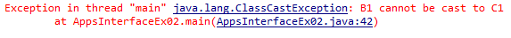
The risks of casting
Question
Check if the following code compiles. If so, what will the output be?
Object obj = new B1();
((C1)obj).methodI1();
Notes:
Answer
The compiler checks command 2 and says to itself: The handle obj is of type C1, does the method methodI1() appear in class C1? The answer is yes and therefore the command can be compiled.
While running, it creates an exception called ClassCastException:
Only while running does Java discover that the handle obj points to an object of type B1 and therefore we can only cast using a class which is in the object B1’s hierarchy tree, but C1 does not belong to B1’s hierarchy tree.

Slide 28
Side note: Composition over inheritance
Sometimes, inheritance isn't the right mechanism:
Suppose we have a Calculator class which has a calculate function
We want to add a Human class which can perform calculate in a way that’s identical to the Calculator
Is this the solution? Is Human a type of Calculator?
The alternative:
We should only use inheritance when the relation is ‘is a’
Human
Calculator
1
calculate():int
itsCalculator
calculate():int
int calculate() { return itsCalculator.calculate(); }

Slide 29
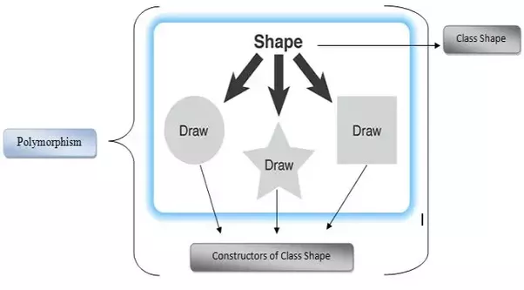
Why do we need interfaces? (4)
Interfaces enables polymorphism

Slide 30
Polymorphism
When there are different implementations of an interface, the same code can be manifested in different behaviors, in accordance with the object being initialized in practice.
public interface Shape {
public double calcPerimeter();
public double calcArea();
}
…
Shape shape;
…
shape.calcPerimeter();
Sometimes, the same code can run a few times in a single execution and lead to different behaviors.
Polymorphism is the key to extendable programming

Slide 31
Different implementations of the Shape interface
public class Rectangle implements Shape { public double width, length; public Circle(double width, double height) { this.width = wdith; this.height = height; } public double calcPerimeter() { System.out.println(“Rectangle calcPerimeter()"); return 2 * (width + length); } public double calcArea() { System.out.println(" Rectangle calcArea"); return width * length; } }
public class Circle implements Shape { public double radius; public Circle(double rad) { radius = rad; } public double calcPerimeter() { System.out.println("Circle calcPerimeter()"); return 2 * Math.PI * radius; } public double calcArea() { System.out.println(" Circle calcArea"); return Math.PI * radius * radius; } }

Slide 32
Different implementations of the Shape interface
public class RightAngleTriangle implements Shape { public double a, b, c; public RightAngleTriangle(double a, double b, double c) { this.a = a; this.b = b; this.c = c; assert a*a + b*b == c*c; } public double calcPerimeter() { System.out.println(“RightAngleTriangle calcPerimeter()"); return a + b + c; } public double calcArea() { System.out.println(“RightAngleTriangle calcArea()"); return (a*b)/2; } }

Slide 33
Initializing different objects of type Shape and operating them
Circle c1 = new Circle(2.5);
System.out.println(c1.calcPerimeter());
Shape s1 = c1; System.out.println(s1.calcPerimeter()); System.out.println(s1.calcArea());
Shape s2 = new Rectangle(3.5, 6); System.out.println(s2.calcPerimeter()); System.out.println(s2.calcArea());
Circle calcPerimeter()
15.70796
Circle calcArea()
19.63495
Circle calcPerimeter()
15.70796
Circle calcArea()
19.63495
Rectangle calcPerimeter()
19
Rectangle calcArea()
21

Slide 34
Polymorphism: The same line of code is expressed in a different behavior
Shape shapes[] = { new Circle(1.5), new RightAngleTriangle(3, 4, 5), new Rectangle(13.5, 4.35), new Circle(4.5), new RightAngleTriangle(5, 12, 13), new Rectangle(23.5, 54.35)}; for (Shape s : shapes) { System.out.println(s.calcPerimeter()); System.out.println(s.calcArea()); }

Slide 35
Declaring a variable of type interface as a field in a class
There’s an interface called Vehicle which defines a drive function
There are different classes which implement Vehicle
Motorcycle
Car
Truck
A class which contains a pointer to Vehicle can work with all types of vehicles:
public class Student { Vehicle vehicle;
public Student(Vehicle vehicle){ this.vehicle = vehicle; }
void study(){ vehicle.drive("JCT"); learn("AOOP&D"); vehicle.drive("home"); }
}

Slide 36
Using interfaces/abstraction allows us to support implementations which don't exist yet!
We can now instantiate a Student with a Vehicle of our choice. The behavior will match the instance we chose.
public static void main(String[] args) { Student student = new Student(new Truck()); student.study(); }
Using interfaces/abstraction supports even implementations that do not exist yet.
In the future, we may develop a Spaceship class which implements Vehicle, we can use the same code of Student to get to JCT by spaceship!

Slide 37
Polymorphism example
class Animal {
void abstract eat();
}
class Herbivores extends Animal {
void eat() { System.out.println("Herbivores Eat Plants"); }
}
class Omnivores extends Animal {
void eat() { System.out.println("Omnivores Eat Plants and meat"); }
}
class Carnivores extends Animal {
void eat() { System.out.println("Carnivores Eat meat"); }
}
class main {
public static void main(String args[]) {
Animal herbivores = new Herbivores(); //upcasting
Animal omnivores = new Omnivores(); //upcasting
Animal carnivores = new Carnivores(); //upcasting
herbivores.eat();
omnivores.eat();
carnivores.eat();
}
}

Slide 38
Polymorphism example
The Output:
Herbivores Eat Plants Omnivores Eat Plants and meat Carnivores eat meat

